Slide 1
Implementation of XP and praxis
-
AKA ”how to run an XP project”

Slide 2
What is XP?
[XP] A light-weight methodology for small-to-medium-sized teams developing software in the face of vague or rapidly changing requirements.
Why EXTREME ?

Slide 3
Why EXTREME
Code reviews are good
  -> review code all the time ->
  -> pair programming
Testing is good -> everybody test all the time (*)
Design is good
  -> always re-design ->
  -> refactoring
Integration testing is good
  -> several times a day (continuous integration)
EXTREME: set all knobs on 10 and see what happens!
(*) use assertions in your code!
https://developer.mozilla.org/en-US/docs/Web/API/console/assert

Slide 4
4 variables
According to XP, there are 4 variables to control in a project:
  Cost
  Time
  Quality
  Scope (how much you implement)
Cannot be all controlled together!
  e.g. low cost, short time and high quality -> minimal scope!
  e.g. large scope, short time and high quality -> high cost!
External forces* pick 3 of these,
development team picks 1
Beck argues -> best to focus on SCOPE
( * = customers, managers )

Slide 5
How to decide/plan the scope?
Take advantage of the 20-80 rule:
”20% of the features provide 80% of the benefit”
How?
  when planning -> use the planning game and user stories [more about this later!]
  when you release -> put a simple system into production early and update it frequently on a very short cycle -> timeboxing!

Slide 6
How to start an XP project
Start by designing the architecture of the system
  the architecture is the highest-level concept of a system in its environment (AKA the spine or skeleton of the system)
In XP you can define your architecture with:
  a spike
    A spike is “a quick explorations into the nature of a potential solution”
    goal: estimating how long a user story will take to implement
    a spike is a user story itself
  a metaphor = logical design
  (e.g. “the new site will work like a library system”)
    identifies the key objects and their interactions
    the metaphor may change over time as you learn more about the system
You will implment the architecture in the first iteration

Slide 7
First iteration
The first iteration must be a functioning skeleton of the system as a whole
  pick a set of simple, basic stories that you expect will force you to create the whole architecture
  the first iteration puts the architecture in place
How to build the system:
  Skinny -> don't need all the features of any component
  The first iteration doesn't have to be useful - it has to be installable
  give it the simplest interface possible
[From the XP book]

Slide 9
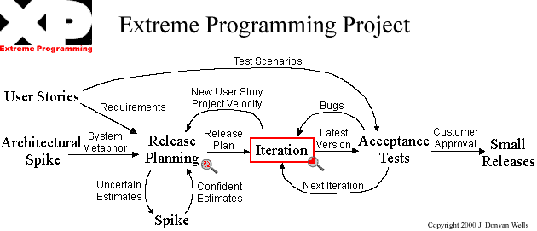
Overview: entire project
(6 months)
[From http://www.extremeprogramming.org/]

Slide 10
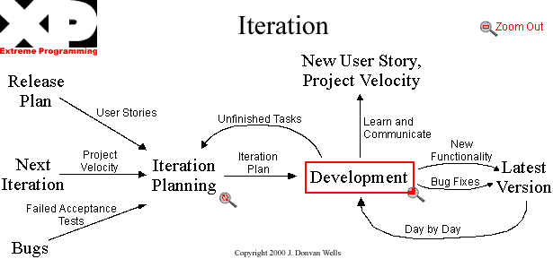
One iteration (15 days)

Slide 11
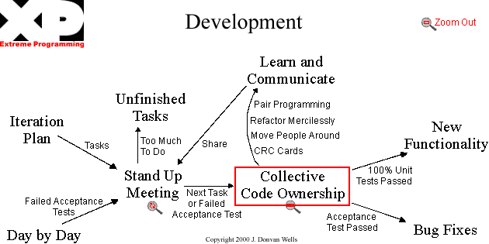
A typical working day

Slide 12
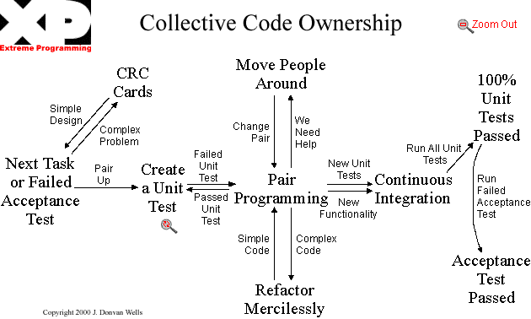
A pair working on 1 task
(20 minutes)

Slide 13
Pair programming means that all code is produced by two people programming on one task on one workstation.
One programmer has control over the workstation and is thinking mostly about the coding in detail. The other programmer is more focused on the big picture, and is continually reviewing the code that is being produced by the first programmer.
Programmers trade roles after minute to hour periods.
The pairs are not fixed; programmers switch partners frequently, so that everyone knows what everyone is doing, and everybody remains familiar with the whole system, even the parts outside their skill set. This way, pair programming also can enhance team-wide communication
https://en.wikipedia.org/wiki/Extreme_programming_practices#Planning_game

Slide 14
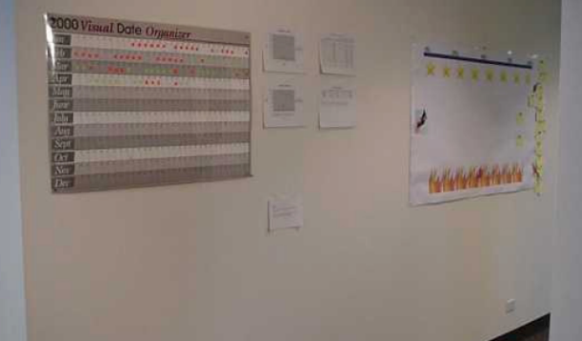
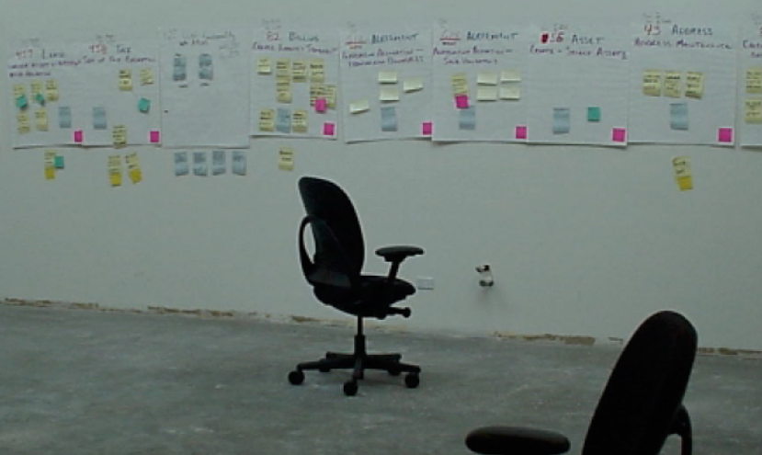
How to arrange your workspace to support XP
put plans, spikes, ideas and solutions on the walls
-> status of the project on the wall

Slide 15
Links
Article about the 20-80 rule: Delivering Value in Software Projects
  http://www.xprogramming.com/xpmag/deliveringvalue.htm
XP - Where's the Architecture?
  http://www.xp123.com/xplor/xp0007b/index.shtml
Tutorial: Extreme Programming (XP)
  http://www.clipcode.biz/workshops/XP.pdf

